Slide 1
The Servlet Model HTTP Methods Form Parameters Requests Responses Servlet Life Cycle #Servlet #Video_Servlet #JavaEE #MVC #MVC2
Kiều Trọng Khánh

Slide 2
Objectives
How to build the simple web site combining html and servlet?
Http Protocol and Methods
What is Servlet?
Parameters vs. Variables
Servlet Life Cycle
Break down structure component in building web application

Slide 3
Objectives
Web based App - PBL
Web
Day 1, 2, 3, 4, 5, 6 – Login
Servlet, JDBC
Day 7, 8, 9 – Search
Break Down
Day 10, 11 – MVC2
JSP
Day 12, 13, 14, 15 – CUD, Shopping Carts
Sessions
Day 16, 17 – Login
JavaBeans
Day 18, 19, 20 – CRUD
MVC 2 Complete - JSTL - Taglib
Day 21, 22, 23 – Filter
MVC2 Using Filter as Controller

Slide 4
Build The Simple Web Requirements
Building the web application can do some following functions as
The user must be authenticated before they want to use this web site using the DB
If the user is invalid, the message “Invalid username and password” is presented, then the link “Click here to try again” is shown that redirect the user to the login page
Otherwise, the search page is redirected.
The GUI of web application is present as following

Slide 5
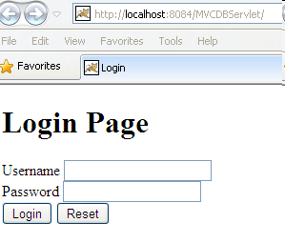
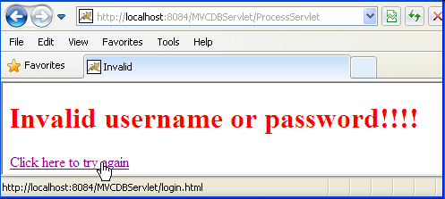
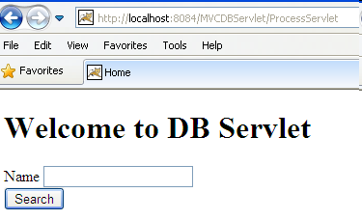
Build The Simple Web Expectation

Slide 6
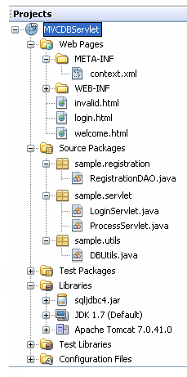
Build The Simple Web Expectation
HTML
Servlet
DB Connection Lib
JDBC Driver

Slide 7
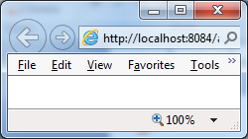
Build The Simple Web Interactive Server Model
2. Send request
Web/App Server
Servlet
1. Click Login
3. Check Login
5. Response the result page
DAO
4. Query DB
6. Browser displays Welcome page/ invalid page
DB
Client
Server

Slide 8
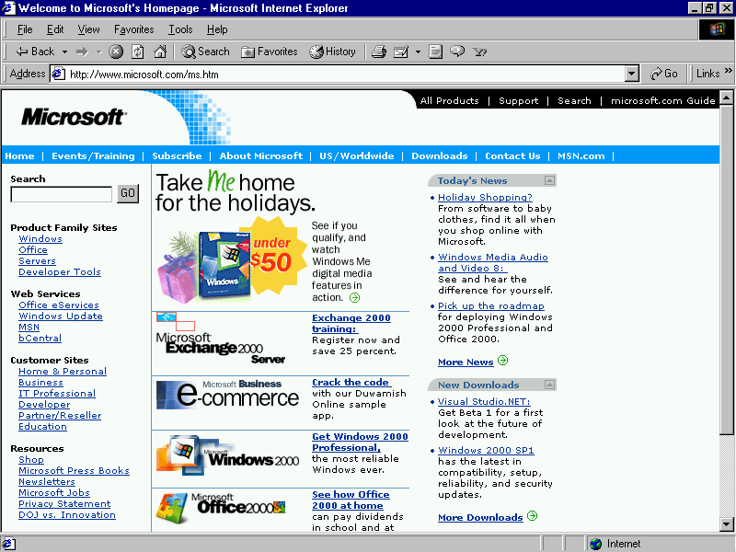
Build The Simple Web Abstraction
Web Server
Container
1. Send request
C
2. Call
3. Query
DB
DAO
5. Response
4. Render/Send
6. Display
V

Slide 9
Build The Simple Web How to Create Web Application Project
Requirement tools: NetBeans IDE 8.x
Create a new Web application project
Using Tomcat Server
JavaEE 6
Uncheck Deploy on Save

Slide 10
HTML Introduction What is HTML?
HTML is a presentation language for describing web pages.
HTML stands for Hyper Text Markup Language
HTML is not a programming language, it is a markup language
A markup language is a set of markup tags
HTML uses markup tags to describe web pages
HTML Documents = Web Pages
HTML documents describe web pages
HTML documents contain HTML tags and plain text
HTML documents are also called web pages

Slide 11
HTML Introduction HTML Tags
HTML markup tags are usually called HTML tags
HTML tags are keywords surrounded by angle brackets, that begin “<” and finish with “>”, like <html>
HTML tags normally come in pairs like <b> and </b>
The first tag in a pair is the start tag, the second tag is the end tag
Start and end tags are also called opening tags and closing tags.
Web Browser
The purpose of a web browser (like Internet Explorer, or Firefox, etc) is to read HTML documents and display them as web pages.
The browser does not display the HTML tags, but uses the tags to interpret the content of the page

Slide 12
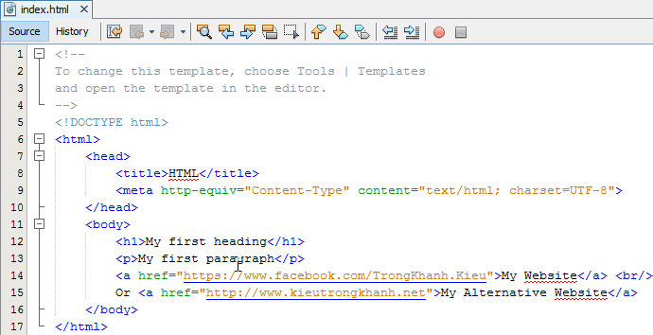
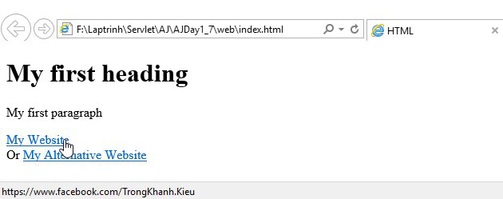
HTML Introduction Example
Notes:
Tạo Web Project, chọn Tomcat, mặc định nó là GlassFish, các trang web gõ tên ko cần gõ đuôi và phải nằm tại thư mục web Pages

Slide 13
Form Parameters HTML Form
A form is defined on a web page starting with the opening tag <form> and ending with closing tag </form>
Syntax: <form action=“target” [method=“HTTP method”]>
action attribute presents value that contains some target resource in the web application (e.g. Servlet or JSP)
method attribute denotes the HTTP method to execute. The default is to execute HTTP GET when the form is submitted
Notes: the action parameter obeys the rules
action=“targetServlet”: the browser will assume that targetServlet resides in the same place the default page as index.jsp or index.html
action=“/targetServlet”: the browser will asume the the path at the root location for specified host (http://host:port).
Ex: http://localhost:8086/targetServlet
action=“target?queryString”:the request send the data in queryString to the URL
Notes:
Ubiquity: có mặt khắp mọi nơi, phổ dụng

Slide 14
Form Parameters Input Tag
Is used to input data
Syntax: <input type=“…” [value=“…” name=“…”] />
type attribute
Dedicates to holding a single line of text (text).
The size attribute specifies the width of text field in characters
The maxlength attribute controls the maximum number of characters that a user can type into the text field
A browser should mask the character typed in by the user (password)
Being a hidden field – is invisible (hidden)
Put one or more small boxes that can be clicked to tick or check the corresponding value denote (checkbox)
checked=“checked” sets up the checkbox as already selected
The choice made is mutual exclusive (radio)
The name attribute is crucial to tying together a group of radio buttons
Send the form data to the URL designated by the action attribute (submit)
A request to the client browser to reset all the values within the form (reset)
Defining the “custom button” which is connected to some soft of script (button)
name attribute supplies the parameter name
value attribute supplies the parameter value
Notes:
Reset không gửi dữ liệu về server

Slide 15
Form Parameters Select & Text Area Tag
HTML Forms – select tag
Sets up a list of values to choose (combo box or pop-up menu, or list box)
Syntax: <select name=“…” [size=“…” multiple] > <option value=“…” [selected]>…</option> … </select>
option tag
The user-visible text goes between opening and closing option tag
The value attribute passes the value in the parameter
multiple attribute presents the control that can choose more than one
HTML Forms – textarea tag
Presents multiple line of text
Syntax: <textarea name=“…” rows=“…” cols=“…”> … </textarea>
The text value put in opening and closing tag is passed as the parameter value to server
rows present the number of visible lines
cols present the number of characters to displayed across the width of the area

Slide 16
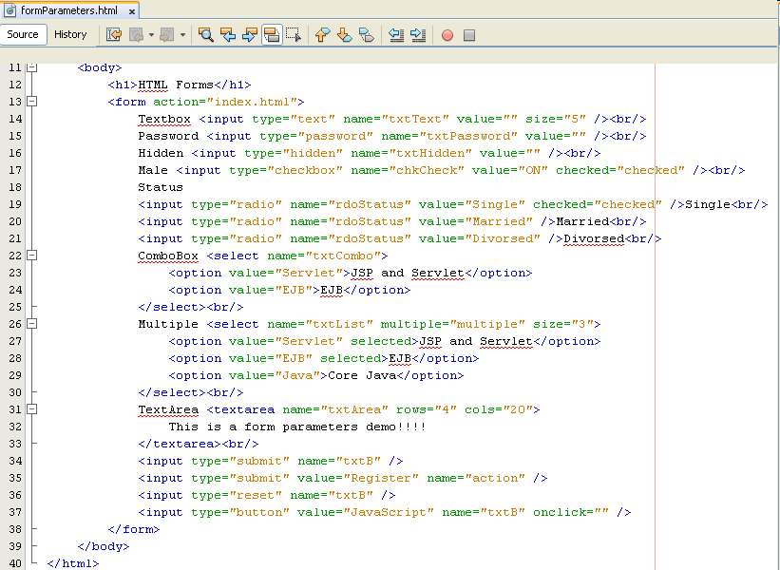
Form Parameters Examples

Slide 17
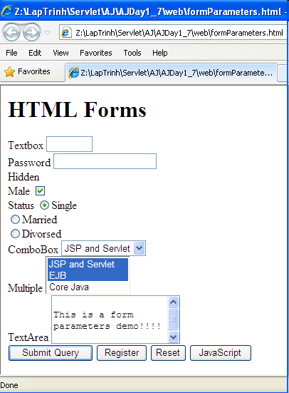
Form Parameters Examples

Slide 18
Build The Simple Web Views

Slide 19
Build The Simple Web Interactive Server Model
2. Send request
Web/App Server
Servlet
1. Click Login
5. Response the result page
3. Check Login
DAO
4. Query DB
6. Browser displays Welcome page/ invalid page
DB
Client
Server

Slide 20
HTTP Protocols Overview
1. Convert http://microsoft.com/ to 192.168.54.3:80
Connect
2. Send a request to Web Server (index.html)
4. The result is responsed to Browser
http://microsoft.com/index.html
192.168.54.3:80
5. Web Browser views the result which contains a markup language
3. Web Server processes a request (connecting DB, calculating, call service …)
Request – Response pairs
Stateless
Port 80 is default
Notes:
Gửi tín hiệu gọi là hand shaking, có khoảng 3 loại tin hiệu là SYN, ACK, SYN thì mới kết nối được

Slide 21
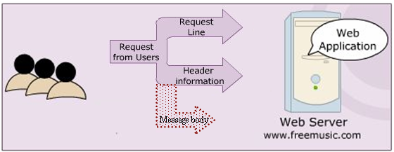
HTTP Protocols HTTP Requests
A carriage return/ line feed
Notes:
Blank line còn có tên khác là A carriage return/line feed – được áp dụng cho phương thức Post
Phần thân chứa tham số truyền – có tên gọi là message, áp dụng cho phương thức Post và đặt tham số truyền dưới blank live và có Content-Length xác định thể hiện kích thươc của message body truyền đi tính bằng byte
Phần host nằm trong phần Header Information, Trạng thái kết nối

Slide 22
HTTP Protocols HTTP Requests
The HTTP method
A pointer to the resource requested, in the form of a URI
The version of HTTP protocol
Ex: GET /index.html HTTP/1.1
A carriage return/ line feed
Notes:
Blank line còn có tên khác là A carriage return/line feed – được áp dụng cho phương thức Post
Phần thân chứa tham số truyền – có tên gọi là message, áp dụng cho phương thức Post và đặt tham số truyền dưới blank live và có Content-Length xác định thể hiện kích thươc của message body truyền đi tính bằng byte
Phần host nằm trong phần Header Information, Trạng thái kết nối

Slide 23
HTTP Protocols HTTP Requests
Return the User-Agent (the browser) along with the Accept header in the form name:value (provides information on what media types the client can accept)
Ex: User-Agent: Mozilla/4.0 (compatible: MSIE 4.0 : Windows 95) Accept : image/gif, image/jpeg, text/*, */*
A carriage return/ line feed
Notes:
Blank line còn có tên khác là A carriage return/line feed – được áp dụng cho phương thức Post
Phần thân chứa tham số truyền – có tên gọi là message, áp dụng cho phương thức Post và đặt tham số truyền dưới blank live và có Content-Length xác định thể hiện kích thươc của message body truyền đi tính bằng byte
Phần host nằm trong phần Header Information, Trạng thái kết nối

Slide 24
HTTP Protocols HTTP Requests
A carriage return/ line feed
Contain pretty much any thing (a set of parameters and values, an image file intending to upload)
Notes:
Blank line còn có tên khác là A carriage return/line feed – được áp dụng cho phương thức Post
Phần thân chứa tham số truyền – có tên gọi là message, áp dụng cho phương thức Post và đặt tham số truyền dưới blank live và có Content-Length xác định thể hiện kích thươc của message body truyền đi tính bằng byte
Phần host nằm trong phần Header Information, Trạng thái kết nối

Slide 25
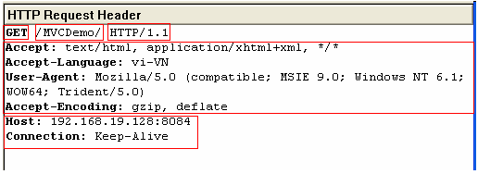
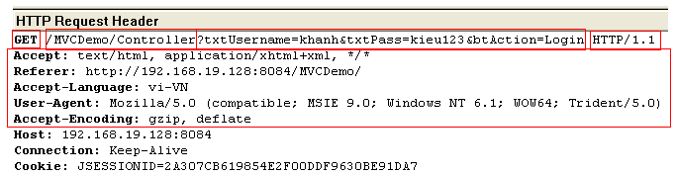
HTTP Protocols HTTP Requests – Example
Notes:
Blank line còn có tên khác là A carriage return/line feed
Phần thân chứa tham số truyền – có tên gọi là message

Slide 26
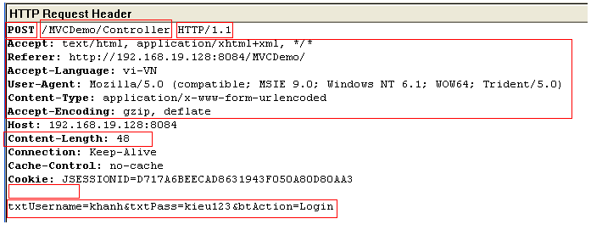
HTTP Protocols HTTP Requests – Example
Notes:
Ví dụ cho phương thức Post, 48 chính là chuỗi truyền đi từ tham số đến ký tự cuối cùng là 48 ký tự

Slide 27
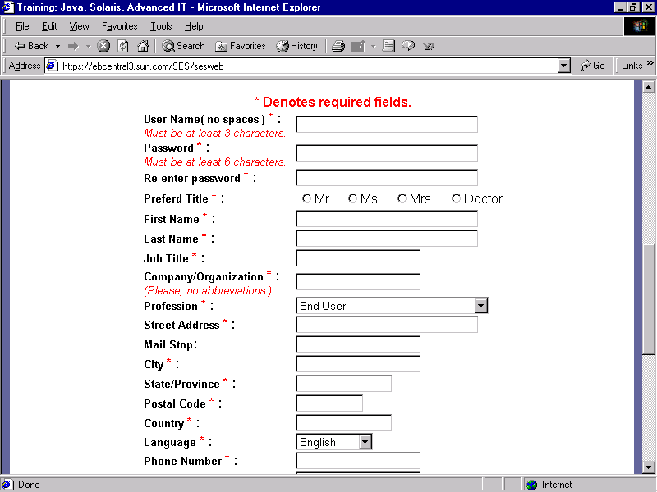
The Servlet Model Request Objects
1. Input and click button/link
3. Send request
4. Dispatch to Servlet/Web Container
Web/App Server
Containter
Request Object
5. Container create Req Obj
2. Generate the Request msg
10. Send response
6. Forward
Response Object
Resources
9. Create Response Msg
8. Set Val
OS
7.retrieve data (if any)
DB
Client
Server
Notes:
Preference: sự ưu tiên
GET : còn gọi là request theo dạng read-only: không cho thay đổi thông tin

Slide 28
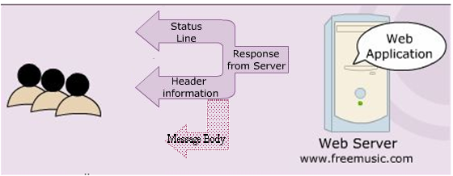
HTTP Protocols HTTP Responses
Blank line
Notes:
Content Length chính là kích thước dữ liệu trả về cho browser

Slide 29
HTTP Protocols HTTP Responses
Indicates status of request process (HTTP version, response code, status)
Ex: HTTP/1.1 200 OK
Server. Ex: Server: JavaWebServer
Last modified date.
Ex: Last-modified: Tuesday, 24-Mar-09 8:30:34 GMT
Content length. Ex: Content-length: 100
Content type. Ex: Content-type: text/plain
Blank line
Notes:
Content Length chính là kích thước dữ liệu trả về cho browser

Slide 30
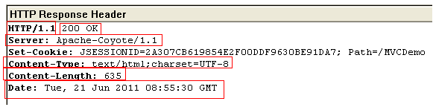
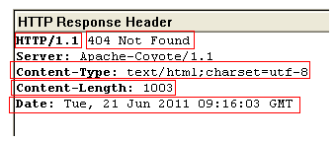
HTTP Protocols HTTP Responses – Example

Slide 31
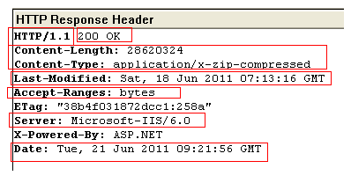
HTTP Protocols HTTP Responses – Example
Notes:
Last-Modified thể hiện lần cuối truy cập, còn Date thể hiện ngày truy cập của cùng session

Slide 32
HTTP Protocols Some commonly Status codes
Code | Associated Message | Meaning
101 | Switching Protocols | Server will comply with Upgrade header and change to different protocol. (New in HTTP 1.1)
200 | OK | Everything is fine; document follow Default for servlets
201 | Created | Server created a document The Location header indicates its URL
203 | Non-Authoritative Information | Document is being returned normally, but some of the response headers might be incorrect since a document copy is being used.
204 | No Content | Browser should keep displaying previous document
301 | MovedPermanently | Document is moved to a separate location as mentioned in the URL. The page is redirected to the mentioned URL, to find the document
302 | Found | Temporary replacement of file from one location to the other as specified
Notes:
Comply: tuân theo, chiếu theo

Slide 33
HTTP Protocols Some commonly Status codes
Status code | Associated Message | Meaning
400 | Bad Request | - The request placed is syntactically incorrect
401 | Unauthorized | - Authorization not given to access a password protected page
403 | Permission denied | - Authentication but authorization not given to access protected resource
404 | Not Found | - Resource not found in the specified address
408 | Request Timeout | - Time taken by client is very long to send the request (only available in HTTP 1.1)
500 | Internal Server Error | - Server is unable to locate the requested file. The servlet has been deleted or crashed or had been moved to a new location with out informing
503 |  | Indicates that the HTTP server is temporarily overloaded, and unable to handle the request
… | … | …

Slide 34
HTTP Protocols HTTP Methods – Basic
GET
Is the method commonly used to request a resource/ get information (access static resource such as HTML doc and images or retrieve dynamic information such as query parameters) from server
The restricted length of query string, that is introduced by the question mark “?”
Is trigger by
Typing into the address line of the browser and pressing GO
Clicking on a link in a web page
Pressing the submit button in an HTML form with GET method
POST
Sends data of unlimited length to the web server.
Is the method commonly used for passing user input/ sending information to the server (access dynamic resources and enable secure data in HTTP request because the request parameters are passed in the body of request)
No limit and cannot be booked mark or emailed
Notes:
Preference: sự ưu tiên
GET : còn gọi là request theo dạng read-only: không cho thay đổi thông tin

Slide 35
HTTP Protocols HTTP Methods – Extends
HEAD
Returns the headers identified by the request URL.
Is identical to the GET method but it doesn’t return a message body
Is an economical way of checking that a resource is valid and accessible
OPTIONS
Returns the HTTP methods the server supports.
PUT
Requests the server to store the data enclosed in the HTTP message body at a location provided in the request URL.
DELETE
Requests the server to delete the resource identified by the request URL.
TRACE
Is used for debugging and testing the request sent to the server. It is useful when the request sent to the server reaches through the proxies.
Idempotency and Safety
GET, TRACE, OPTIONS, and HEAD
Notes:
Idempotency – idempotent: ko thay đổi
Post cho phép thay đổi 1 số nội dung thông tin trên server – update/delete/add.
Sự khác nhau của GET và POST là chỉ đọc và có thể thay đổi
Đây là phương thức chủ yếu trong Web Server được support hiện nay, cụ thể là Tomcat
OPTIONS: trả về HTTP method được server hỗ trợ
PUT: tương tự như POST nhưng nó có khả năng thay thế file trực tiếp và đa số dùng trên FTP
Các phương thức GET, TRACE, OPTIONS và HEAD là ko thay đổi, do vậy an toàn

Slide 36
Build The Simple Web Interactive Server Model
2. Send request
Web/App Server
Servlet
1. Click Login
5. Response the result page
3. Check Login
DAO
4. Query DB
6. Browser displays Welcome page/ invalid page
DB
Client
Server

Slide 37
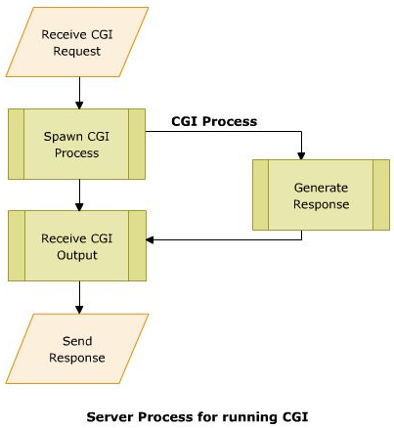
The Servlet Model Common Gateway Interface (CGI)
A small program (*.exe) is written in languages such as C/C++, Perl, ... for the gateway programs.
Used in complex applications, such as Web pages
A set of standards followed to interface applications form client side to a Web Server
Enables the Web server to send information to other files and Web browsers
Helps to process the inputs to the form on the Web page
Enables to obtain information and use it on the server machine (server side)
When the Browser sends request to server, CGI instantaties to receive and process.
Notes:
Gateway: A device that connects networks using different communications protocols so that information can be passed from one to the other. A gateway both transfers information and converts it to a form compatible with the protocols used by the receiving network

Slide 38
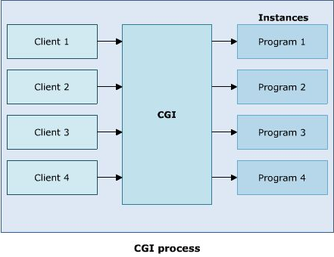
The Servlet Model Common Gateway Interface (CGI)
Disadvantages
Reduced efficiency

Slide 39
The Servlet Model Common Gateway Interface (CGI)
Disadvantages
Reduced efficiency
Reloading Perl interpreter
The widely accepted platform for writing CGI script is Perl. Each time the server receives are quest, the Perl interpreter needs to be reloaded.
Interactive: not suitable for graphical or highly interactive programs
Time consuming and more memory consumed
Debugging: error detection is difficult
Not support Session

Slide 40
The Servlet Model Servlets
Are Java classes that dynamically process HTTP requests and construct responses
Are Java codes that are used to add dynamic content to Web server.
There is only a single instance of Servlet created on the Web server.
To service multiple clients’ request, the Web server creates multiple threads for the same Servlet instance (Overcome CGI’s consumed more memory)
Gets auto refreshed on receiving a request each time
A Servlet’s initializing code is used only for initializing in the 1st time
Merits
Enhanced efficiency (initializing only once, auto refresh)
Ease to use (using Java combining HTML)
Powerful (using Java)
Portable
Safe and cheap
Demerits
Low-level HTML documentation (Static well-formed-ness is not maintained)
Unclear-session management (flow of control within the codes is very unclear)

Slide 41
The Servlet Model Servlets
How to server detecting the servlets (difference from Java class), then, initializing in the 1st time?
Web deployment descriptors (web.xml)
Annotations

Slide 42
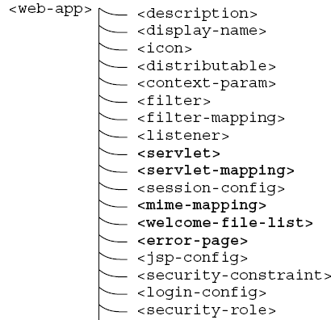
The Servlet Model The Deployment Descriptor
The Web Deployment Descriptor file describes all of Web components
It is an XML file. Given that the name is web.xml.

Slide 43
The Servlet Model The Deployment Descriptor – web.xml
<?xml version="1.0" encoding="UTF-8"?>
<web-app version="2.5" xmlns="http://java.sun.com/xml/ns/javaee" xmlns:xsi="http://www.w3.org/2001/XMLSchema-instance" xsi:schemaLocation="http://java.sun.com/xml/ns/javaee http://java.sun.com/xml/ns/javaee/web-app_2_5.xsd">
<servlet>
<servlet-name>servlet name</servlet-name>
<servlet-class>package.classname</servlet-class>
</servlet>
<servlet-mapping>
<servlet-name>servlet name</servlet-name>
<url-pattern>/context Path/root</url-pattern>
</servlet-mapping>
<session-config>
<session-timeout>30</session-timeout>
</session-config>
<welcome-file-list>
<welcome-file>default page to show</welcome-file>
</welcome-file-list></web-app>
Servlets Declaration is same as package.classname servlet_name;
Define the access path to the servlet;
Notes:
2.4: là version của servlet

Slide 44
The Servlet Model The Deployment Descriptor – Example
<?xml version="1.0" encoding="UTF-8"?>
<web-app version="2.5" xmlns="http://java.sun.com/xml/ns/javaee" xmlns:xsi="http://www.w3.org/2001/XMLSchema-instance" xsi:schemaLocation="http://java.sun.com/xml/ns/javaee http://java.sun.com/xml/ns/javaee/web-app_2_5.xsd">
<servlet>
<servlet-name>HelloServlet</servlet-name>
<servlet-class>servlet.sample.HelloServlet</servlet-class>
</servlet>
<servlet-mapping>
<servlet-name>HelloServlet</servlet-name>
<url-pattern>/HelloServlet</url-pattern>
</servlet-mapping>
<session-config>
<session-timeout>30</session-timeout>
</session-config>
<welcome-file-list>
<welcome-file>HelloServlet</welcome-file>
</welcome-file-list></web-app>

Slide 45
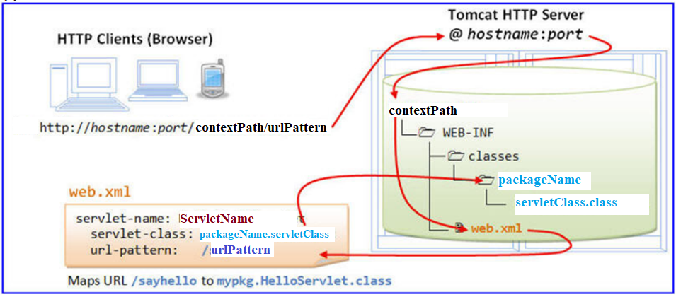
The Servlet Model The Deployment Descriptor – Example
2. Send Request
3. Dispatch to Application
1. User types url
4. Find web.xml
6. Access the servlet instance
5. Look up the servlet class from mapping to find the servlet instance web.xml

Slide 46
The Servlet Model Annotations
Are one of the major advancement from Java EE 5.0 that makes the standard web.xml deployment descriptors files optional
To avoid writing such kind of unnecessary codes, annotations are used
Can be defined as metadata information that can be attached to an element within the code to characterize it
Simplifies the developer’s work to a great extent by significantly reducing the amount of code to be written by moving the metadata information into the source code itself
Are never executed and processed when the code containing it are compiled or interpreted by compilers, deployment tools, and so on
An annotation type takes an ‘at (@)’ sign, followed by the interface keyword and the annotation name
Notes:
There are two approaches adopted in developing Java server-side components namely, imperative programming and declarative programming. The imperative programming approach specifies how to achieve a goal. The declarative programming specifies only the goal, but not the implementation code to achieve that specific goal.

Slide 47
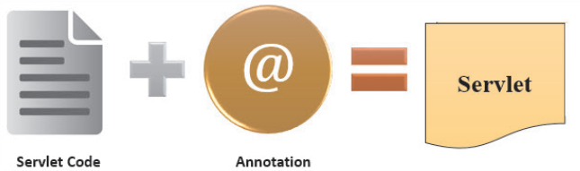
The Servlet Model Annotations – Servlets
The javax.servlet.annotation package provides annotations to declare Servlets by specifying metadata information in the Servlet class
Figure 4.9: Servlet with Annotations, Web Component Development Using Java, Aptech World Wide
Notes:
There are two approaches adopted in developing Java server-side components namely, imperative programming and declarative programming. The imperative programming approach specifies how to achieve a goal. The declarative programming specifies only the goal, but not the implementation code to achieve that specific goal.

Slide 48
The Servlet Model Annotations – Servlets
WebServlet
Is used to provide the mapping information of the Servlet.
Is processed by the servlet container at the time of the deployment.
Attributes | Descriptions
name | Specifies the Servlet name. This attribute is optional.
urlPatterns | An array of url patterns use for accessing the Servlet, this attribute is required and should register one url pattern
initParams | An array of @WebInitParam, that can be used to pass servlet configuration parameters. This attribute is optional.
…
Notes:
There are two approaches adopted in developing Java server-side components namely, imperative programming and declarative programming. The imperative programming approach specifies how to achieve a goal. The declarative programming specifies only the goal, but not the implementation code to achieve that specific goal.

Slide 49
The Servlet Model Servlets
Web
Server
Browser
Client
1. Send Request
Internet HTTP Protocol
2. Choose Servlet Instance
4. Response
ServletContainer
Servlets
3. Query (if any)
Database

Slide 50
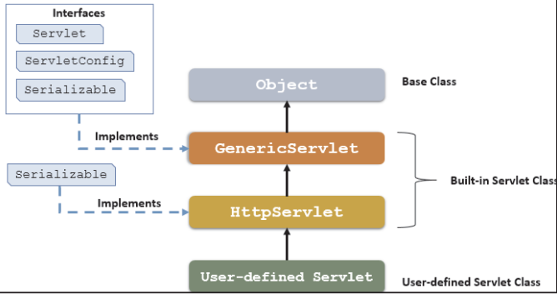
The Servlet Model Architecture of the Servlet packages
The javax.servlet package provides interfaces and classes for writing servlets
The important interface is javax.servlet.Servlet
When a servlet accepts a call from a client, it receives two objects:
ServletRequest, which encapsulates the communication from the client to the server.
ServletResponse, which encapsulates the communication from the servlet to the client.
Notes:
GenericServlet ngoài được kế thừa từ Servlet, nó còn được kế thừa từ ServletConfig, java.io.Serializable
GenericServlet được kế thừa từ phần chính yếu là Servlet, đây là interface cho tất cả servlet và định nghĩa một trong ba phương thức đã được định nghĩa trong chu kỳ sống (init, services, destroy).
HttpServlet được kế thừa từ GenericServlet

Slide 51
The Servlet Model GenericServlet class
Defines a servlet that is not protocol dependent
Implements the Servlet, the ServletConfig, and the java.io.Serializable interfaces
Retrieves the configuration information by implementing the ServletObject
Some methods
Methods | Descriptions
init | - public void init() throws ServletException - Initializes the servlet
service | - public abstract void service(ServletRequest req, ServletResponse res) throws ServletException, IOException - Called by the container to respond to a servlet request
destroy | - public void destroy(): cleaning the servlet
Servlet
Life
Cycle
defined
in Generic

Slide 52
The Servlet Model The Servlet Life Cycle
5. first to n^{th} req
Uninstantiated
Instantiation
Initialization
meet request
1. begin to deploy
Meet multi request
2. deploying
success
init()
success
service()
4. first req
3. deployed
failure
Detroy received request and using thread
failure
Unload
Unavailable
destroy
6. undeploy, server is crashed, unload servlet
destroy()
The life cycle is defined by
init() – called only one by the server in the first request
service() – process the client’s request, dispatch to doXXX() methods
destroy() – called after all requests have been processed or a server-specific number of seconds have passed

Slide 53
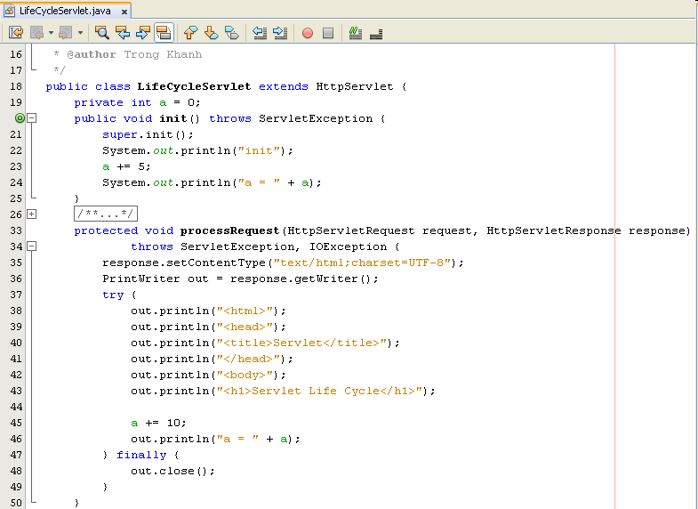
The Servlet Model The Servlet Life Cycle – Example

Slide 54
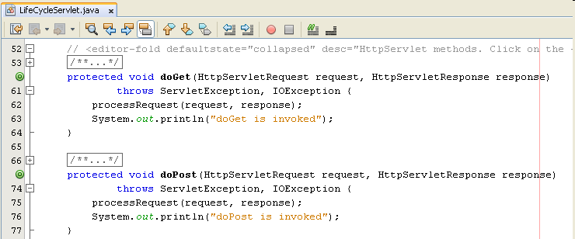
The Servlet Model The Servlet Life Cycle – Example

Slide 55
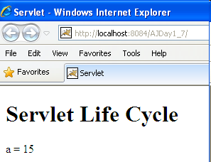
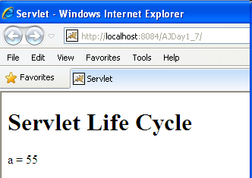
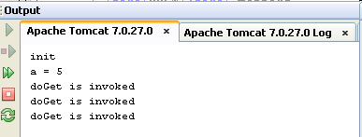
The Servlet Model The Servlet Life Cycle – Example

Slide 56
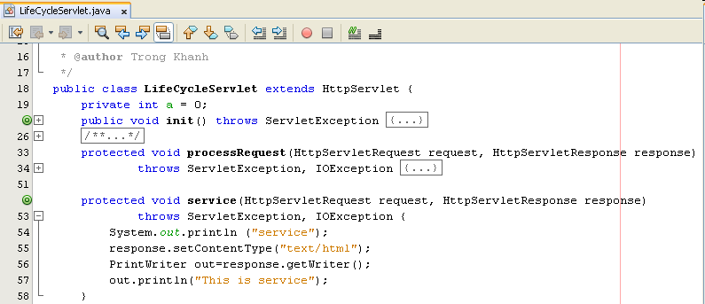
The Servlet Model The Servlet Life Cycle – Example

Slide 57
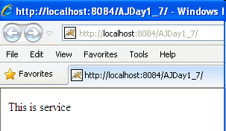

The Servlet Model The Servlet Life Cycle – Example

Slide 58
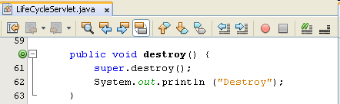
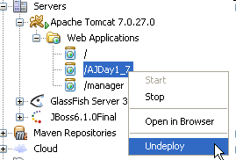
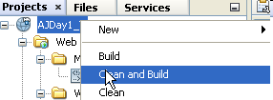

The Servlet Model The Servlet Life Cycle – Example
Addition the destroy method (comment service method)
Execute project again, then undeploy or clean and Build the current project on Tomcat Server

Slide 59
Build The Simple Web Interactive Server Model
2. Send request
Web/App Server
Servlet
1. Click Login
5. Response the result page
3. Check Login
DAO
4. Query DB
6. Browser displays Welcome page/ invalid page
DB
Client
Server

Slide 60
Summary
How to build the simple web site using html and servlet?
Http Protocol and Methods
What is Servlet?
Parameters vs. Variables
Servlet Life Cycle
Break down structure component in building web application
Q&A

Slide 61
Summary
Web Server
Container
1. Send request
C
2. Call
3. Query
DB
DAO
5. Response
4. Render/Send
6. Display
V
Q&A

Slide 62
Summary
1. Input and click button/link
3. Send request
4. Dispatch to Servlet/Web Container
Web/App Server
Containter
Request Object
5. Container create Req Obj
2. Generate the Request msg
10. Send response
6. Forward
Response Object
Resources
9. Create Response Msg
8. Set Val
OS
7.retrieve data (if any)
DB
Q&A
Client
Server

Slide 63
Exercises
Do it again all of demos
Using servlet to write the programs as the following requirement
Present the Login form (naming LoginServlet) with title Login, header h1 – Login, 02 textbox with naming txtUser and txtPass, and the Login button
Writing the ColorServlet that presents “Welcome to Servlet course” with yellow in background and red in foreground

Slide 64
Next Lecture
How to access database from web application?
JDBC
Relational Database Overview
JDBC and JDBC Drivers
JDBC Basics: Processing SQL Statements
Implement CRUD application using MS SQL

Slide 65
Next Lecture
Web based App - PBL
Web
Day 1, 2, 3 – Login
Servlet
Day 7, 8, 9 – Search
Break Down
Day 10, 11 – MVC2
JSP
Day 12, 13, 14, 15 – CUD, Shopping Carts
Sessions
Day 16, 17 – Login
JavaBeans
Day 18, 19, 20 – CRUD
MVC 2 Complete - JSTL - Taglib
Day 21, 22, 23 – Filter
MVC2 Using Filter as Controller
4, 5, 6 – JDBC
Login

Slide 66

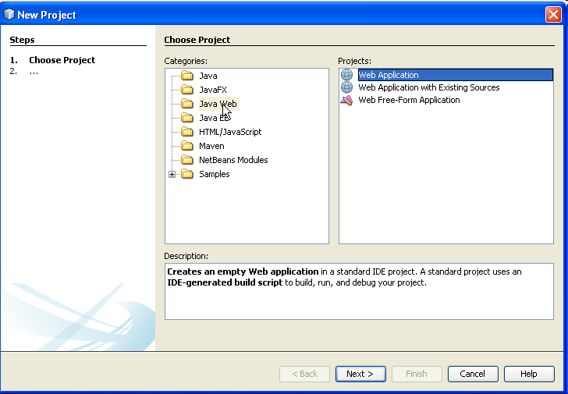
Appendix – Build The Simple Web How to Create Web Application Project
Click Java Web categories
Click the “Web Application” Projects
Click Next button
Notes:
Revive: hồi sinh

Slide 67
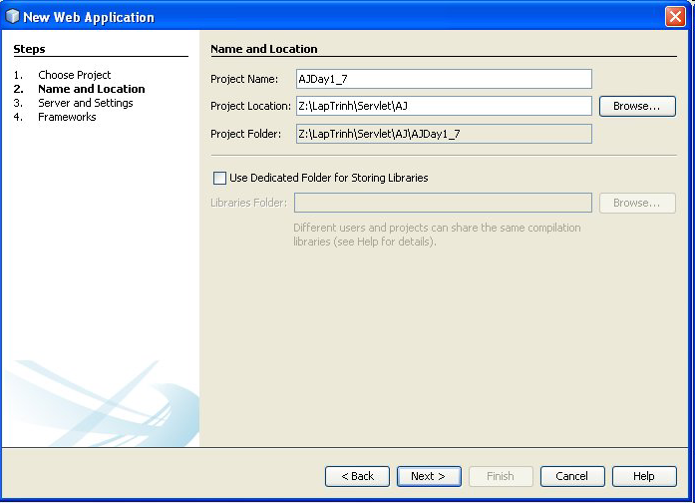
Appendix – Build The Simple Web How to Create Web Application Project
Fill your project name
Browser your location where store the project
Click Next button
Notes:
Revive: hồi sinh

Slide 68
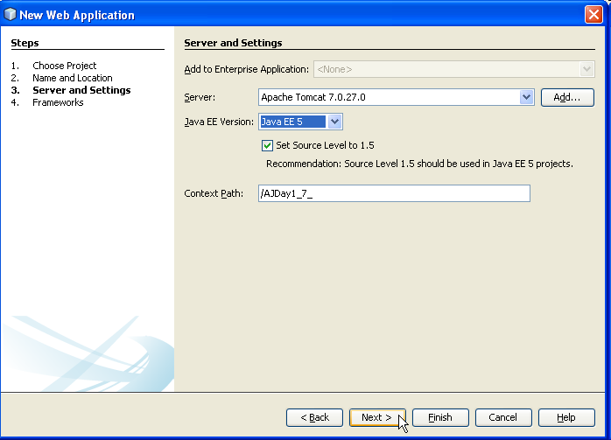
Appendix – Build The Simple Web How to Create Web Application Project
Choose deployed server
Choose Java EE 5/ J2EE 1.4
Modify the context path (if necessary). Defaults, it is named same as Project Name
Click Finish button
Notes:
Revive: hồi sinh

Slide 69
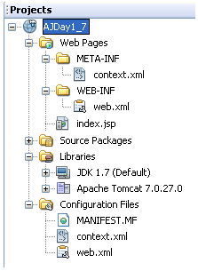
Appendix – Build The Simple Web How to Create Web Application Project
Project name
Web Directory
Web deployment descriptor
Source code directory, containing java class. When project is built, package in classes directory
Support library directory, containing jar file. When project is built, package in lib directory
Configuration directory related define for Web App

Slide 70
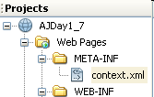

Appendix – Web Applications Add the META-INF/context.xml to project
optional – if it does not exist
Right click the Web Pages, choose New, then choose Other
In New File Dialog, choose Other, then choose Folder, click Next
In New Folder Dialog, type the META-INF into Folder Name
Click Finish
Right click the META-INF, choose New, then choose Other
In New File Dialog, choose XML, then choose XML Document, click Next
In New XML Document Dialog, type context into File Name, click Next, then click Finish
Type the content of content.xml file as (Notes: must type “/” in front of context)

Slide 71
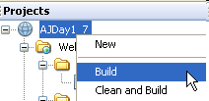
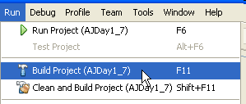

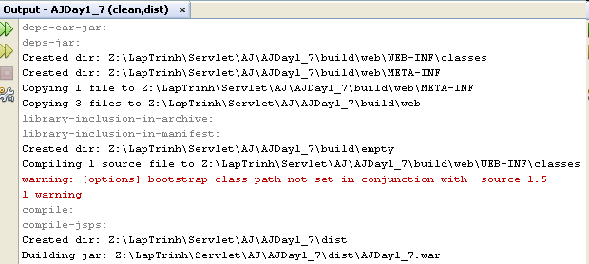
Appendix Build Application

Slide 72
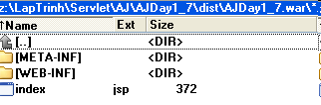

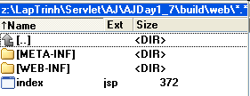
Appendix Build Application
Package War file with command prompt
jar –cvf fileName.war directoryOrFile
Ex: jar –cvf AJDay1_7.war *.jsp WEB-INF/*

Slide 73
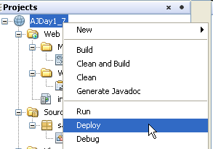
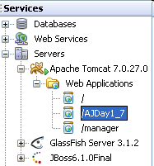
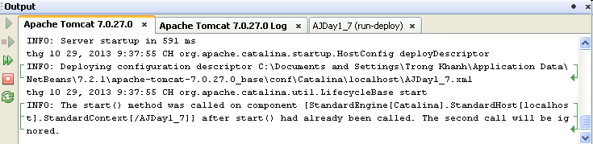
Appendix Deploy Application

Slide 74
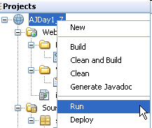
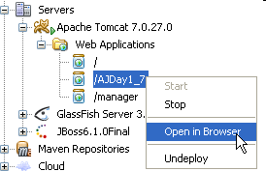
Appendix Run Application

Slide 75

Appendix Run Application

Slide 76


Appendix Additional
Caches of server
WinXP: C:\Documents and Settings\LoggedUser\Application Data\NetBeans\version\apache-tomcat-tomcatVersion_base\work\Catalina \localhost\
Vista or Win7, 8, 10: C:\Users\LoggedUser\AppData\Roaming\NetBeans\version\apache-tomcat-tomcatVersion_base\work\Catalina\localhost\
Above location should be gone and cleared when the application cannot be undeployed or the web servers occur the errors

Slide 77


Appendix Create a Servlet
Click Web categories
Click the “Servlet” File Types
Click Next button

Slide 78

Appendix Create a Servlet
Fill your servlet name
Fill or choose package name
Click Next button

Slide 79

Appendix Create a Servlet
Modify the Servlet Name or URL Pattern if necessary) to configure the servlet information to web.xml
Click Finish button
The servlet class (ex: HelloServlet.java) is added to source packages (with package name if it’s exist) and it’s information is added to xml

Slide 80

Appendix Create a Servlet

Slide 81

Appendix Create a Servlet
Notes:
Yêu cầu test thử chỗ thêm dấu / ở Welcome-file để đưa ra nhận xét context root hiện hành, đường dẫn từ root và đường dẫn hiện hành

Slide 82
The Servlet Model ServletRequest interface
Provides access to specific information about the request
Defines object (ServletRequest object)
Containing actual request (ex: protocol, URL, and type)
Containing raw request (ex: headers and input stream)
Containing client specific request parameters
Is passed as an argument to the service() method
Some methods
Methods | Descriptions
getParameter | - public String getParameter(String name) - Returns the value of a specified parameter by the name (or null or “”) - String strUser = request.getParameter(“txtUser”);
getParameterNames | - public Enumeration getParameterNames() - Returns an enumeration of string objects containing the name of parameters. - Returns an empty enumeration if the request has no parameters - Enumeration strUser = request.getParameterName();
getParameterValues | - public String[] getParameterValues(String names) - Returns an array of string objects containing all of the parameter values or null if parameters do not exist. - String[] value = request.getParameterValues(”chkRemove”);
Notes:
Null: nếu thao số đó không tồn tại
“”: nếu tham số tồn tại mà truyền là rỗng

Slide 83

Appendix – The Servlet Model HttpServletRequest interface – Examples
Notes:
Demo Project AJDay1
Trên URL không có tham số -> POST, 02 control được truyền trị trả về, do vậy, nó là Paramerter, dùng hàm tương ứng là getParameter của request

Slide 84


Appendix – Servlet Model HttpServletRequest interface – Examples
Notes:
Demo Project AJDay1
Trên URL không có tham số -> POST, 02 control được truyền trị trả về, do vậy, nó là Paramerter, dùng hàm tương ứng là getParameter của request

Slide 85

Appendix – The Servlet Model HttpServletRequest interface – Examples
Notes:
Lưu ý trường hợp có form va không có form, có form mà các control đặt ngoài form

Slide 86

Appendix – The Servlet Model HttpServletRequest interface – Examples
Notes:
Lưu ý trường hợp có form va không có form, có form mà các control đặt ngoài form

Slide 87


Appendix – The Servlet Model HttpServletRequest interface – Examples

Slide 88

Appendix – The Servlet Model HttpServletRequest interface – Examples
Notes:
Lưu ý trường hợp có form va không có form, có form mà các control đặt ngoài form

Slide 89

Appendix – The Servlet Model HttpServletRequest interface – Examples

Slide 90

Appendix – The Servlet Model HttpServletRequest interface – Examples

Slide 91

Appendix – The Servlet Model HttpServletRequest interface – Examples
Notes:
Khi dùng POST method, Query String sẽ bằng null, chỉ cho Servlet chạy không, các tham số không truyền, kết quả cũng là 0

Slide 92


Appendix – The Servlet Model HttpServletRequest interface – Examples

Slide 93

Appendix – The Servlet Model HttpServletRequest interface – Examples

Slide 94

Appendix – The Servlet Model HttpServletRequest interface – Examples

Slide 95


Appendix – The Servlet Model HttpServletRequest interface – Examples

Slide 96


Appendix – The Servlet Model HttpServletRequest interface – Examples

Slide 97


Appendix – The Servlet Model HttpServletRequest interface – Examples

Slide 98
The Servlet Model ServletResponse interface
Is response sent by the servlet to the client
Include all the methods needed to create and manipulate a servlet’s output
Retrieve an output stream to send data to the client, decide on the content type ...
Define objects passed as an argument to service() method
Some methods
Methods | Descriptions
getContentType | - public String getContentType() - Returns the Multipurpose Internet Mail Extensions (MIME) type of the request body or null if the type is not known - String contentType = response.getContentType();
getWriter | - public PrintWriter getWriter() throws IOException - Returns an object of PrintWriter class that sends character text to the client, particular Browser. - PrintWriter out = response.getWriter();

Slide 99
The Servlet Model ServletResponse interface
Methods | Descriptions
getOutputStream | - public ServletOutputStream getOutputStream() throws IOException - Uses ServletOutputStream object to write response as binary data to the client. - ServletOutputStream out = response.getOutputStream(); - 02 supporting methods + public void print(boolean b) throws IOException . writes a boolean value to the client with no carriage return line feed (CRLF) character at the end . out.print(b); + public void println(char c) throws IOException . same as the print methods but it writes a character value to the client, followed by a carriage return line feed (CRLF)
setContentType | - public void setContentType(String str) - Used to set format in which the data is sent to the client, either normal text formate or html format - Ex: response.setContentType(“text/html”);

Slide 100
The Servlet Model HttpServletResponse interface
Extends ServletResponse Interface
Defines HttpServlet objects to pass as an argument to the service() method to the client
Set HTTP response, HTTP header, set content type of the response, acquire a text stream for the response, acquire a binary stream for the response, redirect an HTTP request to another URL or add cookies to the response
Methods | Descriptions
encodeRedirectURL | - public String encodeRedirectURL (String url) - Encodes the specified URL for use in the sendRedirect method, or if encoding is not needed, returns the URL unchanged
sendRedirect | - public void sendRedirect(String URL) throws IOException - Sends a redirect response to the client using the specified redirect location URL - the servlet using the sendRedirect method to decide the request handled by particular servlet or - Ex: response.sendRedirect(“process.jsp”);

Slide 101

Appendix – The Servlet Model HttpServletResponse interface - Example

Slide 102

Appendix – The Servlet Model HttpServletResponse interface - Example
Using sendRedirect

Slide 103

Appendix – The Servlet Model HttpServletResponse interface - Example
ResServlet

Slide 104
The Servlet Model HttpServlet class
The protocol defines a set of text-based request messages called HTTP ‘methods’ implemented in HttpServlet class
Provides an abstract class to create an HTTP Servlet
Extends the GenericServlet class
A subclass of HttpServlet class must override at least one of the following methods: doGet(), doPost, doPut(), doDelete(), init(), destroy(), and getServletInfo
Some methods to process the request
Methods | Descriptions
doGet | - protected void doGet(HttpServletRequest req, HttpServletResponse res) throws ServletException, IOException - called by container to handle the GET request. - This method is called through service() method
doPost | - protected void doPost(HttpServletRequest req, HttpServletResponse res) throws ServletException, IOException - called by container to handle the POST request. - This method is called through service() method

Slide 105

The Servlet Model HttpServletRequest interface
Extends ServletRequest Interface
Add a few more methods for handling HTTP-specific request data
Defines an HttpServletRequest object passed as an argument to the service() method

Slide 106

Appendix – Build The Simple Web Login Page

Slide 107

Appendix – Build The Simple Web Search Page

Slide 108

Appendix – Build The Simple Web Invalid Page

